Slide 1
Strength Training for Rowing
What to do, how to do it.

Slide 2
Who are we?
Greg Morgan
B. Sc. (Honours) Sports Science
Level 2 ASCA Coach
Recently left WAIS as S & C coach for Rowing, Cycling etc. squads to study Physiotherapy
Leon Vogels
B.Sc. Physiotherapy Msc. Sports Physiotherapy
Senior Australian Rowing Team Physiotherapist 2013->
WAIS Physio for Rowing and Cycling

Slide 3
Rowing S and C- Guiding Principles
Develop robust athletes and minimise any potential injuries.
• Improve the movement efficiency of the athlete’s rowing stroke.
• Develop underlying physical capacities (strength, power, strength endurance and general athletic competencies e.g (pelvic stability, scapular stability, thoracic mobility, squat pattern etc) which improve performance.
Develop a needs analysis, expose athlete to a variety of exercises early don’t load poor technique
Notes:
e.g. Quadriceps and Back – Hip Strength

Slide 4
Guiding Principles - Youth
Adolescent Rowers
Boys -2-3 x/week max
Girls- 3x/week x 12 weeks, why?
Periodization - Overall time in gym} x2 for intensity x time calculations
Injury Prevention
Males in general need flexibility
Females in general need trunk/hip strength
Notes:
Kim Brennan examples

Slide 5
Guiding Principles - 3
Need to sacrifice something to work in to the training week if introducing strength
Taper – Volume down velocity up, ?frequency down,
In similar sports research has shown that gym is the key difference between successful masters athletes and those less successful

Slide 6
The basics
Hip hinge
Deadlift
Squat
Horizontal pulling
Vertical pulling
Pushing
Piecing it all together

Slide 7
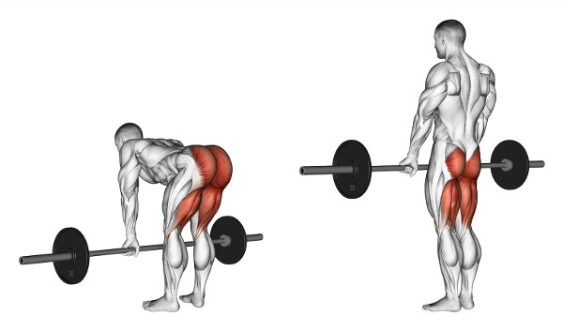
Hip hinge (RDL)
The rock-over in the boat
Starting point to learn to dissociate hip from lumbar flexion
Romanian Deadlift (RDL)
Good Morning, Back Extension, SB Lean Back
“look over edge of cliff”
“keep hips high”
“what initiates movement?”
http://www.darkironfitness.com/

Slide 8
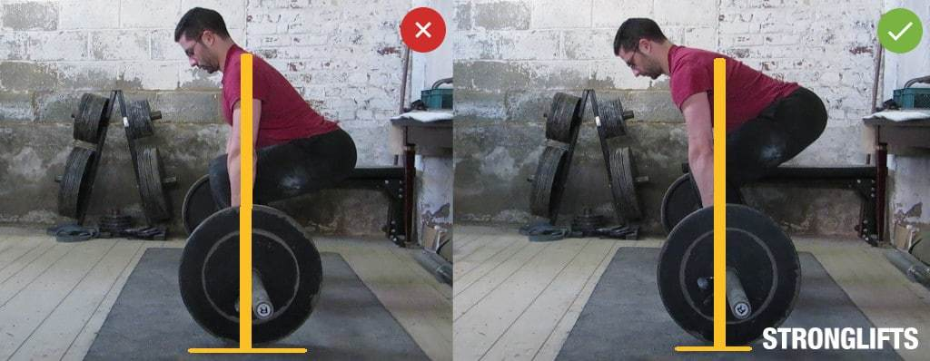
Deadlift – a bit more knees
Closest movement you will get to rowing stroke
See what happens in boat in the Deadlift – bum shoot, head leads
“stay over the bar”
”stand tall, not back”
“connection off floor”
To put down or not?
https://stronglifts.com/wp-content/uploads/deadlift-shoulders.jpg

Slide 9
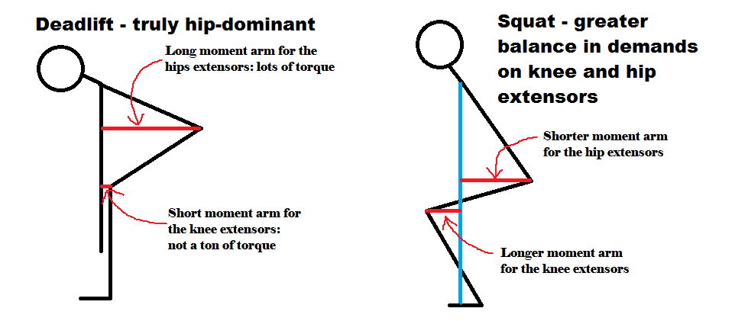
Squat – and a bit more knees
Chance to get depth / full compression
From the floor up:
“foot marks in the sand”
“open the front, close the back”
“what moves first?”
“eyes up, not head up”
https://www.strongerbyscience.com/

Slide 10
Horizontal pulling
Seated Row is easiest to get scapular motion correct
Another exercise where often direct correlation with faulty movements in boat
“Elbows slightly away from body”
“Top of shoulder blades back”
“Bottom of shoulder blades wrap around forwards”
Bench Pull, Horizontal Pull-up and single arm variations.

Slide 11
Vertical pulling
Chin-up variations for closed chain emphasis
Oar in water as a lever to pull yourself / boat around

Slide 12
Pushing
Volume of work to keep muscular balance → injury prevention
Points from pulling in reverse
Push-up → DB Bench Press → Bench Press
Vary angles (incline, decline) for range of stimulus

Slide 13
Core
Philosophy? – Endurance vs. Strength, Specific vs. Integrated
Bracing / Anti-rotation
Bridges, Palloff Press, Back Extension holds, Woodchops?
Rotation
Woodchops?, Russian Twist variations, Windscreen wipers
Hip Stability
Glute Bridge, Cable Kickbacks, Single leg assisted work
Hip Hinge patterning
not lumbar flexion / extension, sometimes better able to be achieved in relaxed back position

Slide 14
Piecing it together
Philosophy? → Strength, endurance, metabolic conditioning
Need of athlete
Training age
Performance short fall
Learning / patterning movement

Slide 15
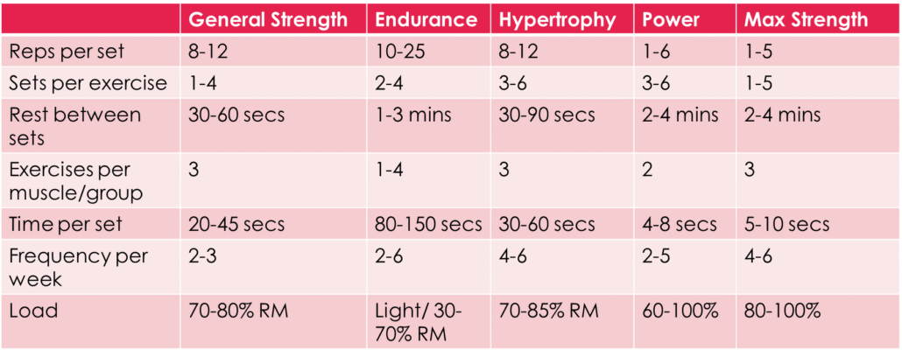
Sets, Reps, Rest
Total 20-25 sets
Rest for strength!
http://ministryofmovement.fitness/2016/06/01/the-simple-framework-to-design-programs-like-personal-trainers/

Slide 16
Thankyou for listening!

